Slide 1
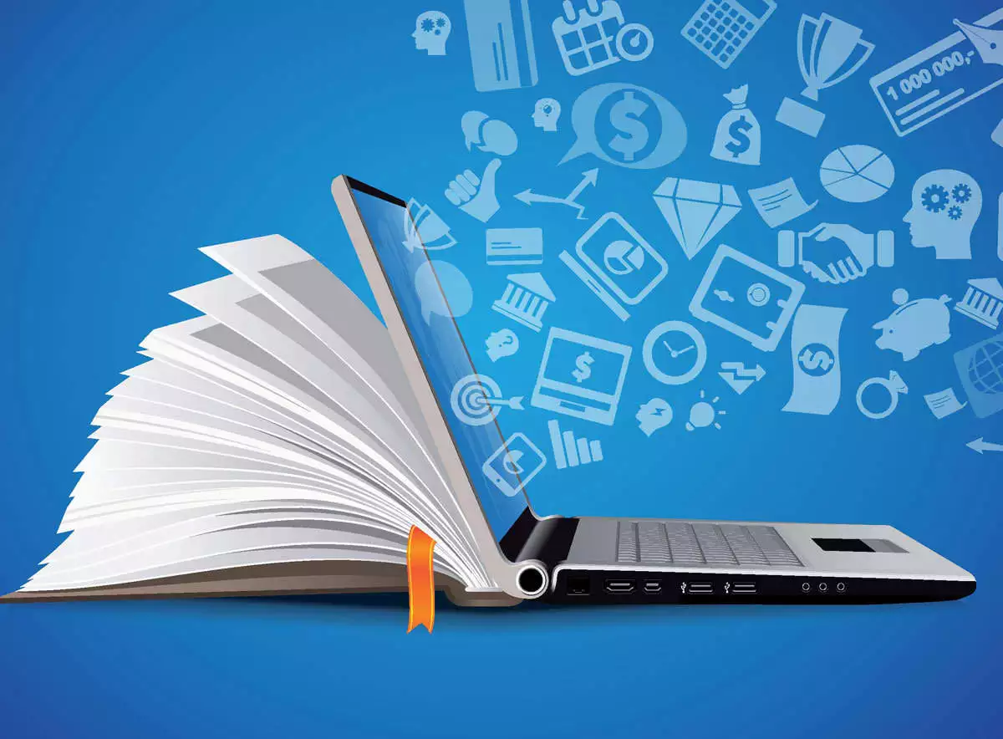
What Is Information Technology? A Beginner’s Guide to the World of IT

Slide 2
For many people, information technology (IT) is basically synonymous with the people you call when you need help with a computer issue. While that view of information technology isn't totally wrong, it drastically understates the scope of this critical career field.
If you're looking to get a better handle on what information technology is - and the many facets of this field - then you've come to the right place. We're going to take a deep dive into the ever-changing world of information technology.

Slide 3
What is information technology and what does it encompass?
The most basic information technology definition is that it's the application of technology to solve business or organizational problems on a broad scale.
No matter their specific IT role, members of an IT department work with others to solve technology problems, both big and small. Information technology plays such a vital role in today's wireless world

Slide 4
To enhance operational efficiency, many global companies compete for a workforce with salient technical skills and often hire network administration professionals, network monitoring staff, user support technicians, network architects, other architecture experts and many other individuals.
You might already know that an IT department serves to ensure that the computer network, computer hardware, computing devices, and other physical devices all function properly. However, there are three primary pillars of responsibility for an IT department:

Slide 5
IT governance: This refers to the combination of policies and processes that ensure IT systems are effectively run and in alignment with the organization's needs.
IT operations: This is a catchall category for the daily work of an IT department. This includes providing tech support, network maintenance, communication protocols, security testing and device management duties.

Slide 6


IT departments also help to automate the business environment and create processes for many of their respective company's daily tasks, so that the business continues to run smoothly.
The ideal IT department is also aligned with the business's goals. Additionally, the department should always be transparent in its processes - providing valuable insights in a way that the rest of the business can understand and provide input on.

Slide 7
What’s the difference between hardware and software?
You know that working with hardware and software is a large part of an IT department's work, but what counts as hardware? And what’s software? Let’s break down this important distinction.
Hardware includes all the physical parts of a computer system. This includes hardware installed inside the computer like the motherboard, central processing unit and hard drive. Hardware also describes components that can be connected to the outside of a computer like a keyboard, mouse and printer.
Keep in mind though that some tablets and smaller laptops integrate items like a keyboard and a mouse within the device. Basically, hardware is any part, component or device related to computers, other devices and their networks that you can physically touch and manipulate.

Slide 8
Why is information technology so important?
Simply put, the work of most organizations would slow to a crawl without functioning IT systems. The Society for Information Management’s (SIM) IT trends report features many different IT functions that are critical to businesses worldwide.1 Here’s just a small sample of what current and future IT specialists will be working on.

Slide 9
Data overload issues
Businesses need to process huge amounts of data. This requires large amounts of data processing and power, sophisticated software and human analytical skills.
Mobile and wireless usages
More employers are offering remote work options that require smartphones, tablets and laptops with wireless hotspots and roaming ability.
Cloud computing services
Most businesses no longer operate their own “server farms” to store massive amounts of data. Many businesses now work with cloud services—third-party hosting platforms that maintain that data.

Slide 10

Video hosting and bandwidth issues
Videoconferencing solutions have become more and more popular, so more network bandwidth is needed to support them sufficiently.
AI and machine learning
Artificial intelligence (AI) and machine learning allow businesses to automate, scale up and use complicated models to anticipate everything from market changes to weather patterns. With the massive volume of data these days, AI is quickly becoming a mainstay in the business world.
Cybersecurity
Cybersecurity is all about securing computer systems all about securing computer systems, networks and data. As businesses depend on their digital systems to function, cyber-attacks that threaten to delete or stall those functions can get pose a massive threat. Theft of private data is also a huge concern, requiring dedicated cybersecurity measures to consistently repel thieves.

